Slide 1
Multi-Objective Reinforcement Learning
Analysing Human Preference Application
Max Cunningham
Date 21/03/25

Slide 2
Overview
Motivation & Objective
Background & Related Work
Design
Implementation
Evaluation
Conclusions

Slide 3





Motivation & Objective
Motivation
Complex Environments
with Multiple Objectives
Groups of Humans with Different, Complex, Dynamic Preferences

Slide 4
Motivation & Objective
Objective
Review:
The current state-of-the-art MORL Models
Methods of Human Preference Integration
Design a Collaborative ML Architecture with Post-Hoc Preference integration.
Test and Evaluate the Novel Architecture using DWN experiments.
Analyse the the Impact of Human Preference integration.

Slide 5
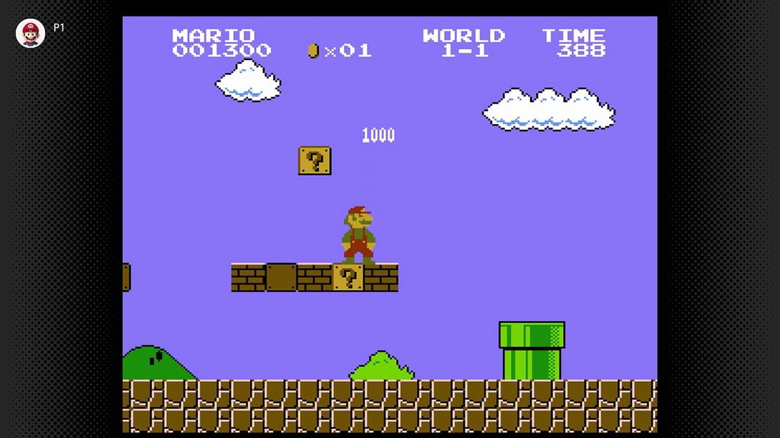
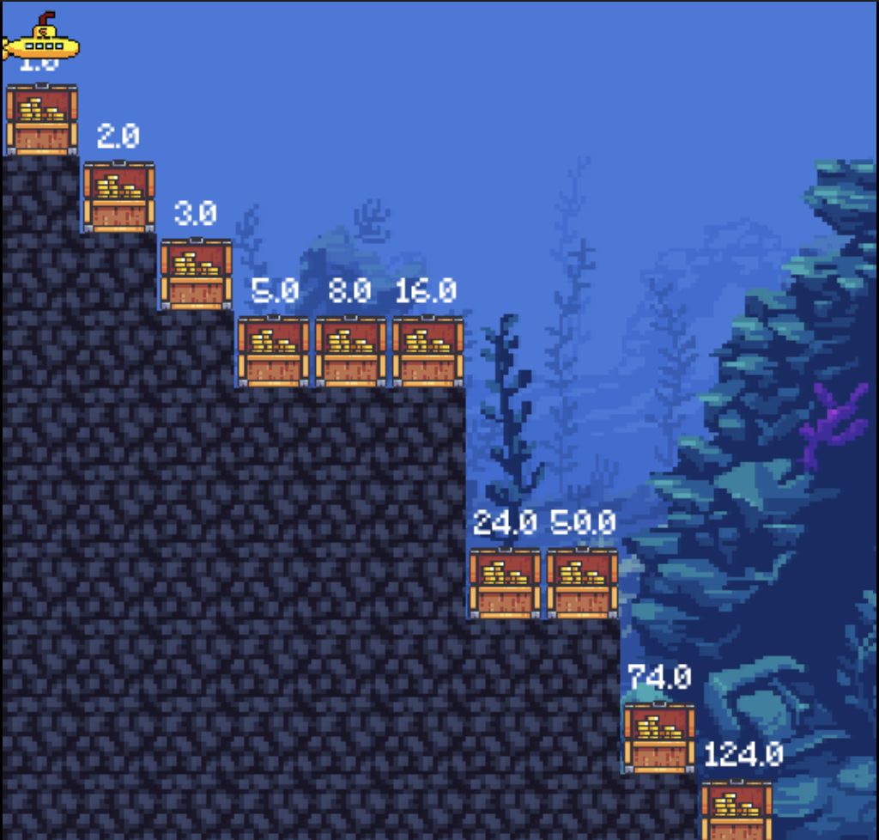
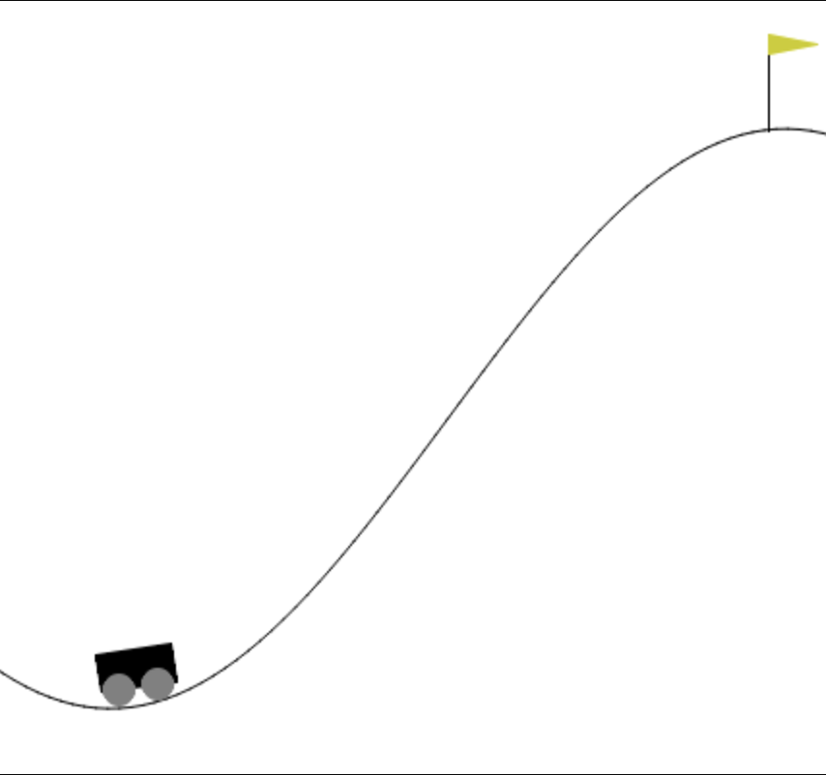
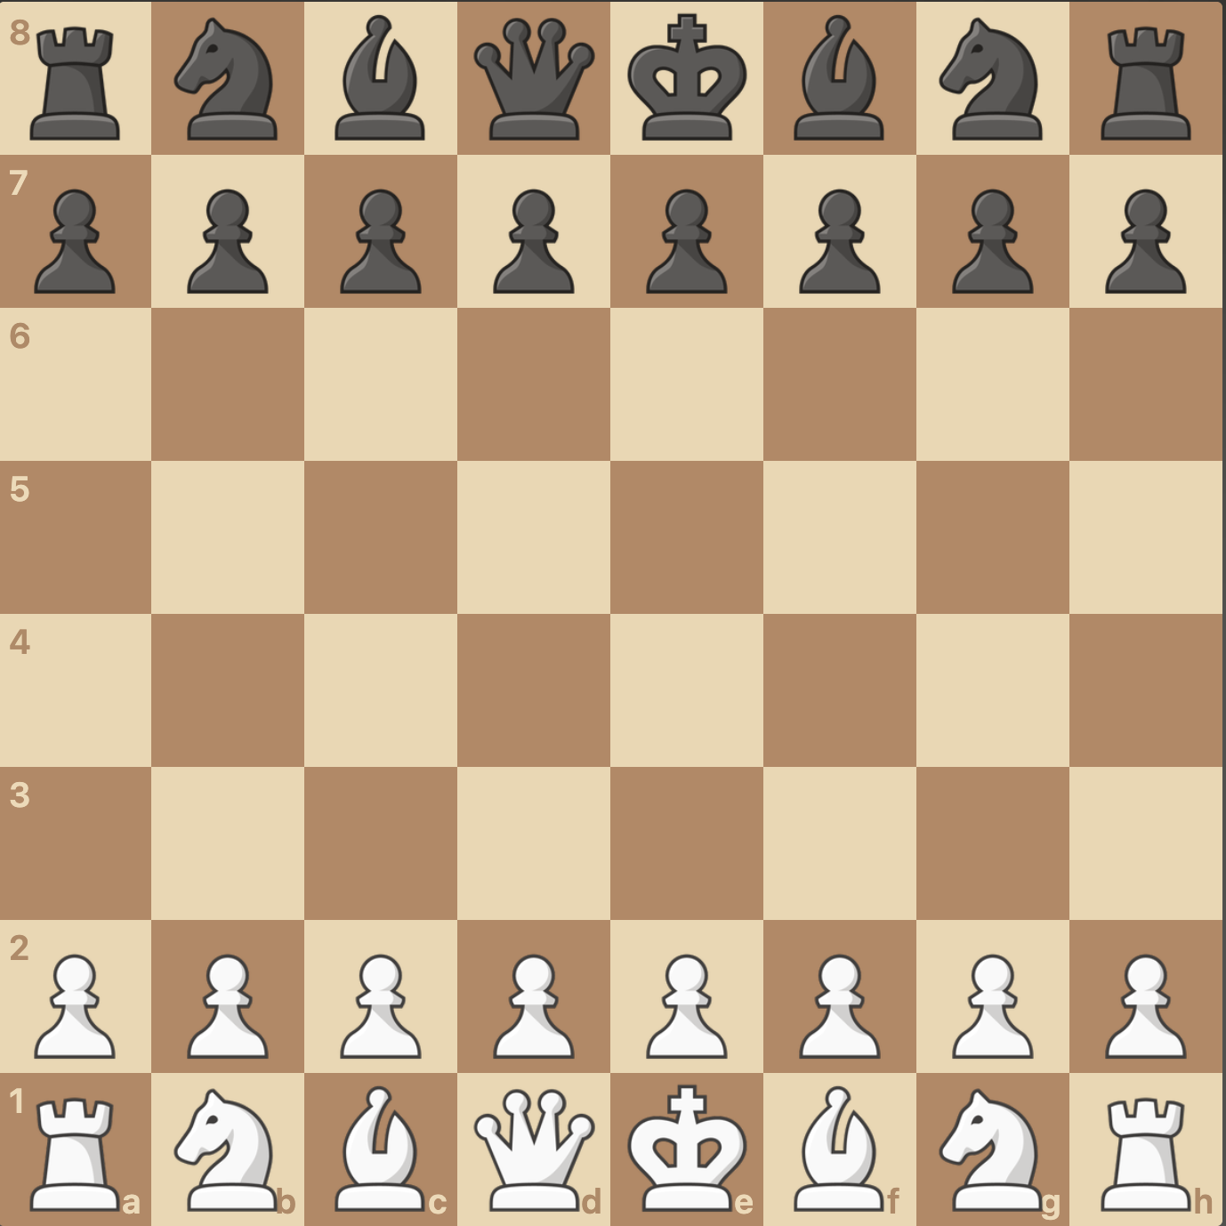





Background & Related Work
What is RL?
Reinforcement Learning (RL)
Agent
Goal = Maximize Reward
state
$$S_{t}$$
reward
$$R_{t}$$
action
$$A_{t}$$
$$R_{t+1}$$
Environment
$$S_{t+1}$$

Slide 6





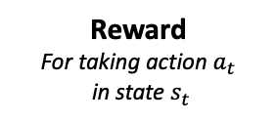



Background & Related Work
Deep Q-Networks (DQN)
ENV
$$s_{1}$$
DQN
NN
$$a_{i}=\underset{i}{argmax}{Q(s,a_{i})}$$
$$Q(s,a_{1})$$
$$Q(s,a_{2})$$
$$Q(s,a_{n})$$
$$s_{2}$$
$$r_{1}$$
$$r_{1}+γQ(s_{2},a_{max})$$
Learning Rate
Discount Factor
$$Q\left(s_{t},a_{t}\right)←Q\left(s_{t},a_{t}\right)+α [r_{t}+γ{\max_{ }}_{a}{Q\left(s_{t+1},a\right)}−Q\left(s_{t}, a_{t}\right)]$$
New Q-Value
Q-Value
Reward
For taking action $a_{t}$
in state $s_{t}$
Maximum Q-Value in Next State
Q-Value

Slide 7

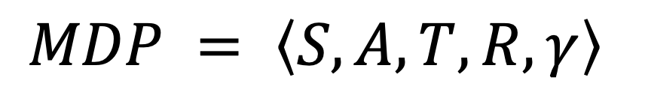










Background & Related Work
RL vs MORL
Reinforcement Learning (RL)
Multi-Objective RL (MORL)
Agent
Agent
state
$$S_{t}$$
reward vector
$$R$$
state
$$S_{t}$$
reward
$$R_{t}$$
action
$$A_{t}$$
action
$$A_{t}$$
$$R_{t+1}^{n}$$
Environment
$$R_{t+1}$$
Environment
$$R_{t+1}^{0}$$
$$S_{t+1}$$
$$S_{t+1}$$
$$MDP = \left\langle S, A, T, R, γ\right\rangle$$

Slide 8
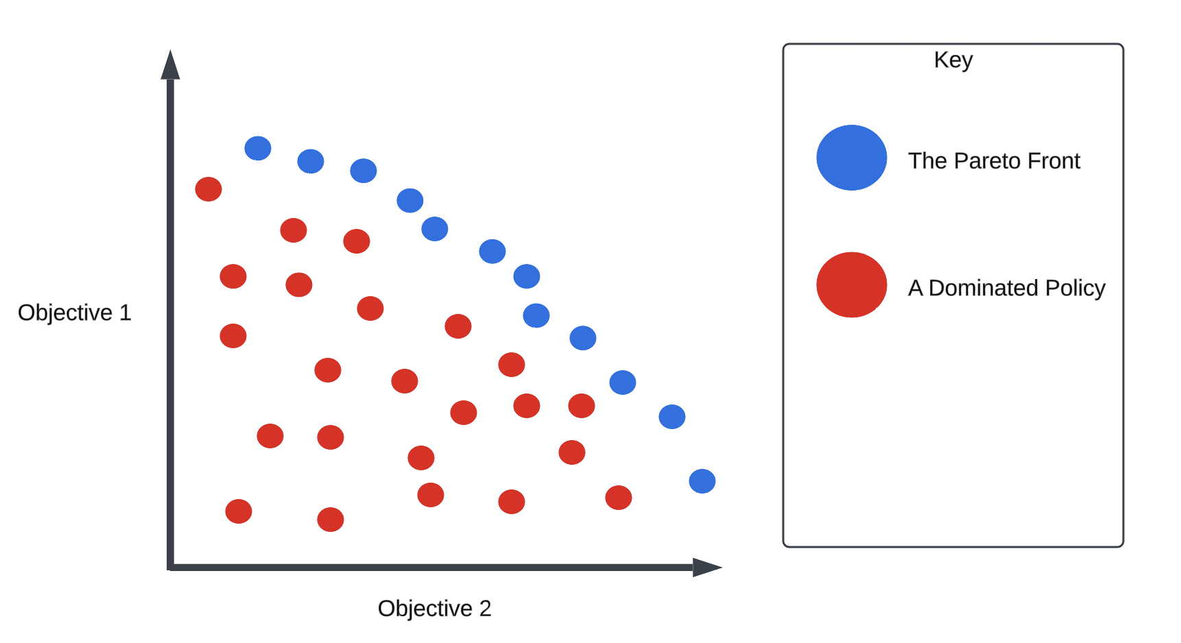
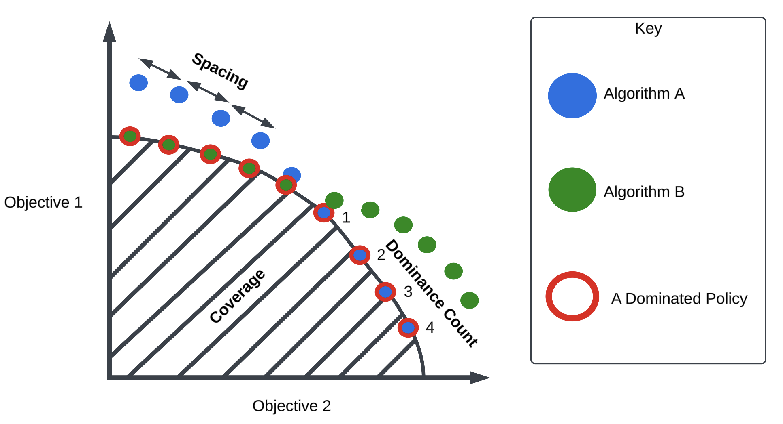


Background & Related Work
Evaluating MORL Models
$$P=\{x∣∄x^{′} s.t. x≻x′\}$$
$$x≻x^{′}⇔∀i∈\left\{1,2,…,n\right\}{ x}_{i}≥x_{i}^{′}$$

Slide 9


















Background & Related Work
MORL Approaches
Scalarization
Multi-Solution
$$R={θ_{1}R}_{1}+θ_{2}R_{2}+…+θ_{n}R_{n}$$
$$s$$
Model
$$a_{θ1}$$
Model
Model
$$s$$
$$a$$
$$s$$
$$a_{θ2}$$
$$s$$
Model
$$a_{θ3}$$
Preference Learning
Multi-Policy
Model
$$s$$
Model
$${\text{Model}}_{1}$$
$$o_{1}$$
Selector
$$θ$$
$$a$$
$$s$$
$${\text{Model}}_{2}$$
$$a$$
$$o_{2}$$
$${\text{Model}}_{n}$$
$$o_{n}$$

Slide 10











Background & Related Work
RL vs MORL
Scalarization
Multi-Solution
$$R={θ_{1}R}_{1}+θ_{2}R_{2}+…+θ_{n}R_{n}$$
$$s$$
Model
$$a_{θ1}$$
Model
Model
$$s$$
$$a$$
$$s$$
$$a_{θ2}$$
$$s$$
Model
$$a_{θ3}$$
Preference Learning
Multi-Policy
Model
$$s$$
Model
$${\text{Model}}_{1}$$
$$o_{1}$$
Selector
$$θ$$
$$a$$
$$s$$
$${\text{Model}}_{2}$$
$$a$$
$$o_{2}$$
$${\text{Model}}_{n}$$
$$o_{n}$$

Slide 11
Background & Related Work
RL vs MORL
Scalarization
Multi-Solution
$$R={θ_{1}R}_{1}+θ_{2}R_{2}+…+θ_{n}R_{n}$$
$$s$$
Model
$$a_{θ1}$$
Model
Model
$$s$$
$$a$$
$$s$$
$$a_{θ2}$$
$$s$$
Model
$$a_{θ3}$$
Preference Learning
Multi-Policy
Model
$$s$$
Model
$${\text{Model}}_{1}$$
$$o_{1}$$
Selector
$$θ$$
$$a$$
$$s$$
$${\text{Model}}_{2}$$
$$a$$
$$o_{2}$$
$${\text{Model}}_{n}$$
$$o_{n}$$

Slide 12









Background & Related Work
Deep W-Learning / W-Networks
DWN
$${\text{Model}}_{1}$$
Selector
DQN
$$a_{1}$$
W-network
$$w_{1}$$
$$argmax_{i}[w_{i}]$$
Select the action with the highest associated W-Value
$${\text{Model}}_{n}$$
DQN
$$a_{n}$$
W-network
$$w_{n}$$
$$i,a_{i}$$
State
Environment
$$a_{i}$$
Reward N
Reward 1
$$W_{j}\left(s_{t}\right)←\left(1−α\right)W_{j}\left(s_{t}\right)+α\left[Q_{j}\left(s_{t},a_{i}\right)−\left(r_{t,j}+γ\max_{a^{′}}{Q_{j}\left(s_{t+1},a^{′}\right)} \right)\right]$$
Humphrys, Mark. (2000). W-learning: Competition among selfish Q-learners.
Jernej Hribar, Luke Hackett, and Ivana Dusparic. (2023). Deep W-Networks: Solving Multi-Objective Optimisation Problems with Deep Reinforcement Learning.

Slide 13
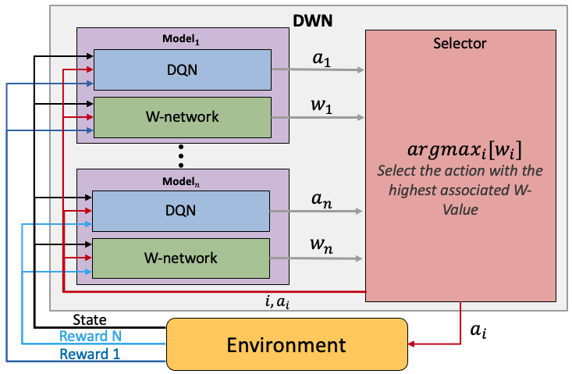
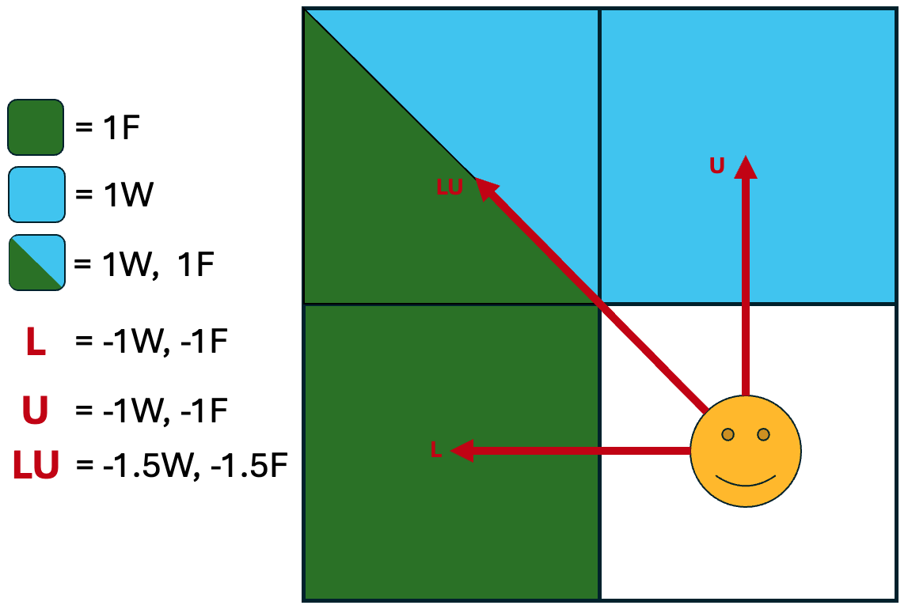
Background & Related Work
Deep W-Learning / W-Networks
Strengths:
Train Greedy DQNs simultaneously.
Learns the Pareto Front.
Naturally divides the state space.
Human Preference Weights are applied Post-Hoc to the W-values.
Weaknesses:
Computationally Intensive.
Human Preference Integration is not clearly understood.
Unable to select collaborative actions.

Slide 14
Design
Novel Architecture
Design a Multi-Policy RL Model which takes Collaborative Actions and Applies Human Preferences post-hoc.
Retain from DWN:
Training single objective DQNs in parallel.
Learning the Pareto Front.
Research Goals:
Enable Multi-Policy Collaborative Actions.
Evaluate our Novel Architecture against DWN.
Analyze Human Preference application in DWNs, and our novel Architecture.
New Features:
Ability to select Collaborative Actions.
Additions to DWN:
Modify DWN to take human preference weights.

Slide 15

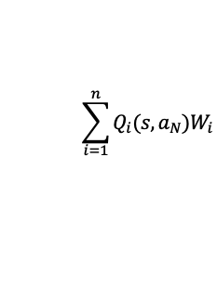




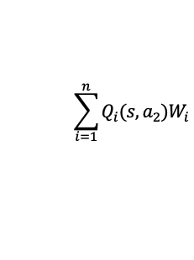




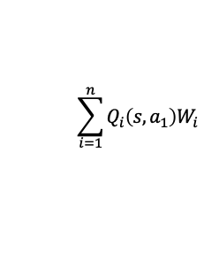



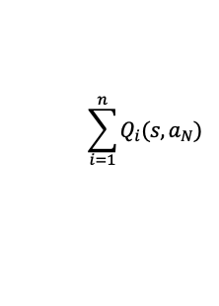






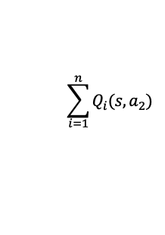





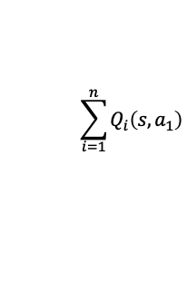



Design
Novel Architecture Approaches
Democratic DWN
Democratic Network
$${\text{Model}}_{1}$$
$$Q_{1}(s,a_{1})$$
Selector
$${\text{Model}}_{1}$$
Selector
DQN
$$Q_{1}(s,a_{2})$$
DQN
$$Q_{1}(s,a_{1})$$
$$…$$
$$\sum_{i=1}^{n}{Q_{i}\left(s,a_{1}\right)W_{i}}$$
$$Q_{1}(s,a_{2})$$
$$\sum_{i=1}^{n}{Q_{i}\left(s,a_{1}\right)}$$
$$Q_{1}(s,a_{N})$$
W-network
$$w_{1}$$
$$…$$
$$Q_{1}(s,a_{N})$$
$$\sum_{i=1}^{n}{Q_{i}(s,a_{2})W_{i}}$$
$$\sum_{i=1}^{n}{Q_{i}(s,a_{2}) }$$
$$A=$$
$$A=$$
$${\text{Model}}_{n}$$
$$…$$
$${\text{Model}}_{n}$$
$$…$$
$$Q_{n}(s,a_{1})$$
DQN
$$Q_{n}(s,a_{2})$$
$$\sum_{i=1}^{n}{Q_{i}(s,a_{N})W_{i}}$$
DQN
$$Q_{n}(s,a_{1})$$
$$\sum_{i=1}^{n}{Q_{i}(s,a_{N}) }$$
$$…$$
$$Q_{n}(s,a_{2})$$
$$Q_{n}(s,a_{N})$$
W-network
$$w_{n}$$
$$…$$
$$Q_{n}(s,a_{N})$$
$$a_{i}=argmax_{i}[A_{i}]$$
$$a_{i}=argmax_{i}[A_{i}]$$
$$a_{i}$$
$$a_{i}$$
State
Environment
$$a_{i}$$
State
Environment
$$a_{i}$$
Reward N
Reward N
Reward 1
Reward 1

Slide 16
Design
Democratic DWN Analysis
Democratic DWN
$${\text{Model}}_{1}$$
Selector
Strengths:
Enables Collaborative action selection.
Retains Division of State Space through W-learning.
Post-Hoc weights can be applied to W-values pre-Selector.
$$Q_{1}(s,a_{1})$$
DQN
$$Q_{1}(s,a_{2})$$
$$…$$
$$\sum_{i=1}^{n}{Q_{i}\left(s,a_{1}\right)W_{i}}$$
$$Q_{1}(s,a_{N})$$
W-network
$$w_{1}$$
$$\sum_{i=1}^{n}{Q_{i}(s,a_{2})W_{i}}$$
$$A=$$
$${\text{Model}}_{n}$$
$$…$$
$$Q_{n}(s,a_{1})$$
DQN
$$Q_{n}(s,a_{2})$$
$$\sum_{i=1}^{n}{Q_{i}(s,a_{N})W_{i}}$$
$$…$$
Drawbacks:
Computationally intensive.
Difficult to assign updates to W-networks.
$$Q_{n}(s,a_{N})$$
W-network
$$w_{n}$$
$$a_{i}=argmax_{i}[A_{i}]$$
$$a_{i}$$
State
Environment
$$a_{i}$$
Reward N
Reward 1

Slide 17
Design
Democratic Network Analysis
Democratic Network
Strengths:
Enables Collaborative action selection.
Post-Hoc weights can be applied during Selector summation.
Computationally less intensive.
$${\text{Model}}_{1}$$
Selector
DQN
$$Q_{1}(s,a_{1})$$
$$Q_{1}(s,a_{2})$$
$$\sum_{i=1}^{n}{Q_{i}\left(s,a_{1}\right)}$$
$$…$$
$$Q_{1}(s,a_{N})$$
$$\sum_{i=1}^{n}{Q_{i}(s,a_{2}) }$$
$$A=$$
$${\text{Model}}_{n}$$
$$…$$
DQN
$$Q_{n}(s,a_{1})$$
$$\sum_{i=1}^{n}{Q_{i}(s,a_{N}) }$$
$$Q_{n}(s,a_{2})$$
Drawbacks:
No longer learns W-values to divide up the state space.
Moving away from DWN theory.
$$…$$
$$Q_{n}(s,a_{N})$$
$$a_{i}=argmax_{i}[A_{i}]$$
$$a_{i}$$
State
Environment
$$a_{i}$$
Reward N
Reward 1

Slide 18

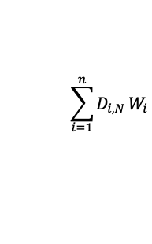

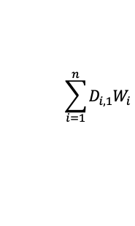

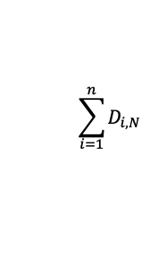
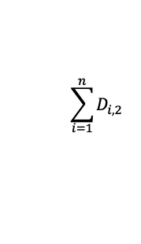



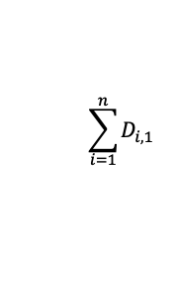

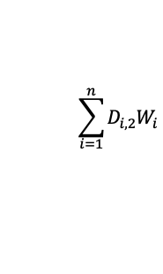

Design
Novel Architecture Approaches (Scaled)
Democratic DWN
Democratic Network
$${\text{Model}}_{1}$$
Selector
$${\text{Model}}_{1}$$
Selector
DQN
$$Q_{1}(s,a_{1})$$
softmax
$$D_{1,1}$$
DQN
$$Q_{1}(s,a_{1})$$
$$Q_{1}(s,a_{2})$$
$$D_{1,2}$$
softmax
$$D_{1,1}$$
$$…$$
$$…$$
$$\sum_{i=1}^{n}{D_{i,1}W_{i}}$$
$$Q_{1}(s,a_{2})$$
$$D_{1,2}$$
$$\sum_{i=1}^{n}{D_{i,1}}$$
$$Q_{1}(s,a_{N})$$
$$D_{1,N}$$
$$…$$
$$…$$
W-network
$$w_{1}$$
$$D_{1,N}$$
$$Q_{1}(s,a_{N})$$
$$\sum_{i=1}^{n}{D_{i,2}W_{i}}$$
$$\sum_{i=1}^{n}{D_{i,2} }$$
$$A=$$
$$A=$$
$${\text{Model}}_{n}$$
$$…$$
$${\text{Model}}_{n}$$
$$…$$
DQN
$$Q_{n}(s,a_{1})$$
softmax
$$D_{n,1}$$
$$\sum_{i=1}^{n}{D_{i,N} W_{i}}$$
DQN
$$\sum_{i=1}^{n}{D_{i,N} }$$
$$Q_{n}(s,a_{2})$$
$$D_{n,2}$$
$$Q_{n}(s,a_{1})$$
softmax
$$…$$
$$…$$
$$Q_{n}(s,a_{2})$$
$$D_{1,1}$$
$$Q_{n}(s,a_{N})$$
$$D_{n,N}$$
$$D_{1,2}$$
$$w_{n}$$
$$…$$
$$…$$
W-network
$$D_{1,N}$$
$$Q_{n}(s,a_{N})$$
$$a_{i}=argmax_{i}[A_{i}]$$
$$a_{i}=argmax_{i}[A_{i}]$$
$$a_{i}$$
$$a_{i}$$
State
Environment
$$a_{i}$$
State
Environment
$$a_{i}$$
Reward N
Reward N
Reward 1
Reward 1

Slide 19
Design
Democratic DWN Analysis
Democratic DWN
$${\text{Model}}_{1}$$
Selector
Strengths:
Enables Collaborative action selection.
Retains Division of State Space through W-learning.
Post-Hoc weights can be applied to W-values pre-Selector.
Functions even with imbalanced rewards.
DQN
$$Q_{1}(s,a_{1})$$
softmax
$$D_{1,1}$$
$$Q_{1}(s,a_{2})$$
$$D_{1,2}$$
$$…$$
$$…$$
$$\sum_{i=1}^{n}{D_{i,1}W_{i}}$$
$$Q_{1}(s,a_{N})$$
$$D_{1,N}$$
W-network
$$w_{1}$$
$$\sum_{i=1}^{n}{D_{i,2}W_{i}}$$
$$A=$$
$${\text{Model}}_{n}$$
$$…$$
DQN
$$Q_{n}(s,a_{1})$$
softmax
$$D_{n,1}$$
$$\sum_{i=1}^{n}{D_{i,N} W_{i}}$$
$$Q_{n}(s,a_{2})$$
$$D_{n,2}$$
$$…$$
$$…$$
$$Q_{n}(s,a_{N})$$
$$D_{n,N}$$
W-network
$$w_{n}$$
Drawbacks:
Computationally intensive.
Difficult to assign updates to W-networks.
$$a_{i}=argmax_{i}[A_{i}]$$
$$a_{i}$$
State
Environment
$$a_{i}$$
Reward N
Reward 1

Slide 20
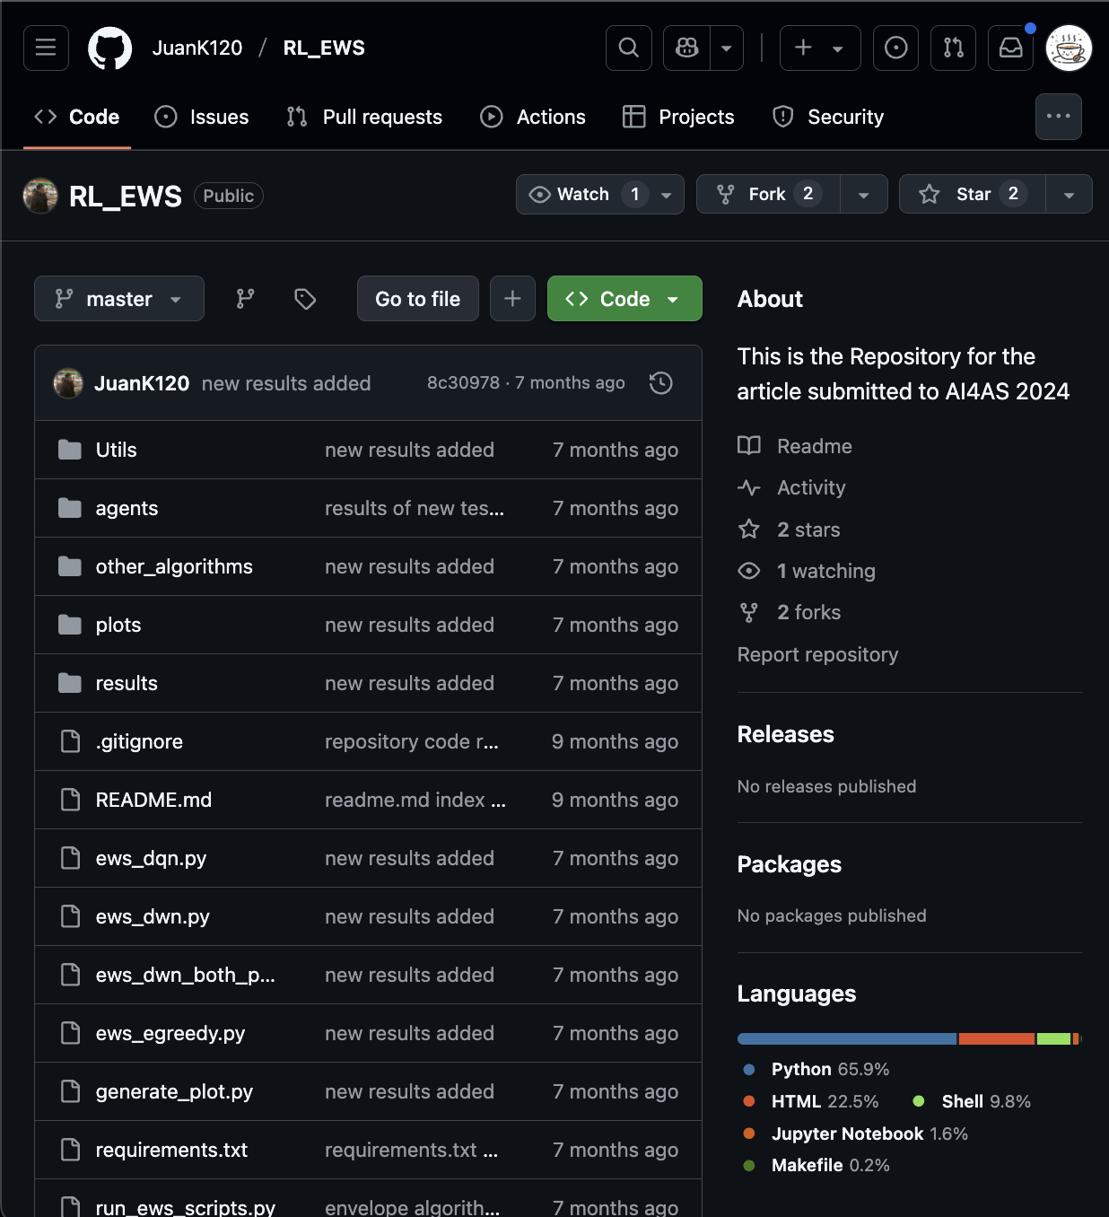


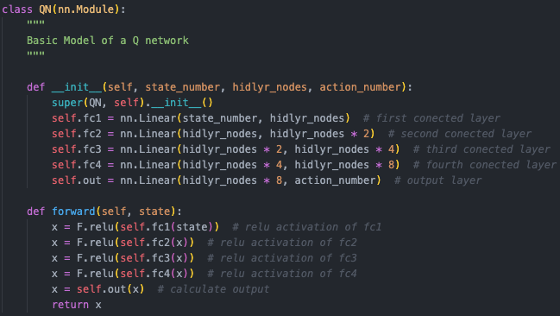
Implementation
Implementing These Models
https://github.com/JuanK120/RL_EWS

Slide 21
Evaluation
Diagrams
Resolution of diagrams should be adequate i.e. lines should not be blurred, fonts should be easily readable
Axes on graphs should have names and units
Graphs should have legends

Slide 22
Conclusions
Lessons learnt
Reflection

Slide 23
Questions ?

Slide 24
Thank You

Slide 25
Title
Subtitle
Body text
Body text

Slide 26
Title
Subtitle

Slide 27
Title
Subtitle
Level 1
Level 2
Level 2

